Slide 1
Modeling Grammaticality*
*more precisely, using
grammaticality to model
acceptability
600.465 - Intro to NLP - J. Eisner
1

Slide 2
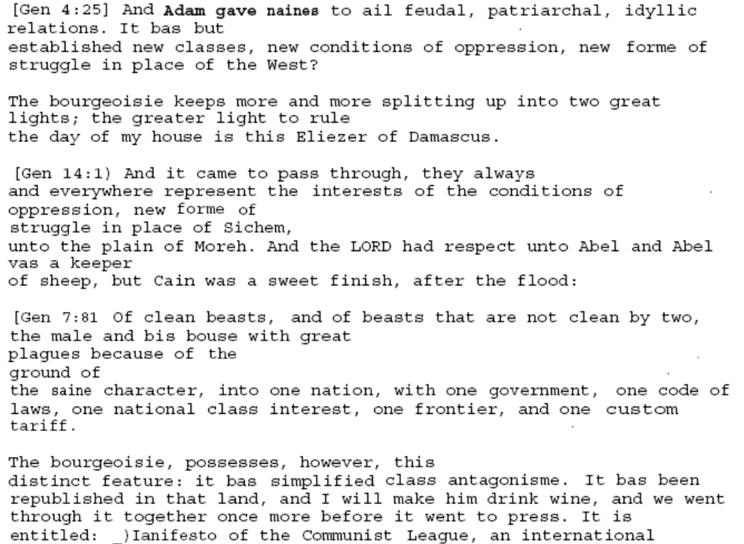
Word trigrams:
A good model of English?
Which sentences are acceptable?
✓
names
all
?
has
s
✓
?
forms
?
was
✗
his house
no main verb
same
600.465 - Intro to NLP - J. Eisner
s
has
has

Slide 3
Why it does okay …
We never see “the go of” in our training text.
So our dice will never generate “the go of.”
  That trigram has probability 0.

Slide 4
Why it does okay … but isn’t perfect.
We never see “the go of” in our training text.
So our dice will never generate “the go of.”
  That trigram has probability 0.
But we still got some unacceptable sentences …
  All their 3-grams are “attested” in the training text, but still the sentence isn’t good.
You shouldn’t eat these chickens because these chickens eat arsenic and bone meal …
3-gram model
Training sentences
… eat these chickens eat …

Slide 5
Why it does okay … but isn’t perfect.
We never see “the go of” in our training text.
So our dice will never generate “the go of.”
  That trigram has probability 0.
But we still got some unacceptable sentences …
  All their 3-grams are “attested” in the training text, but still the sentence isn’t good.
Could we rule these bad sentences out?
  4-grams, 5-grams, … 50-grams?
  Would we now generate only acceptable English?

Slide 6
Acceptable English sentences
Possible under
trained 50-gram
model ?
Training sentences
Possible under trained 3-gram model
(can be built from observed 3-grams by rolling dice)
Possible under trained 4-gram model

Slide 7
What happens as you increase the amount of training text?
Possible under
trained 50-gram
model ?
Training sentences
Possible under trained 3-gram model
(can be built from observed 3-grams by rolling dice)
Possible under trained 4-gram model

Slide 8
What happens as you increase the amount of training text?
Training sentences
(all of English!)
Now where are the 3-gram, 4-gram, 50-gram boxes?
Is the 50-gram box now perfect?
(Can any model of language be perfect?)
Can you name some non-blue sentences in the 50-gram box?

Slide 9
Are n-gram models enough?
Can we make a list of (say) 3-grams that combine into all the acceptable sentences of English?
Ok, how about only the acceptable sentences?
How about all and only?

Slide 10
Can we avoid the systematic problems with n-gram models?
Remembering things from arbitrarily far back in the sentence
  Was the subject singular or plural?
  Have we had a verb yet?
Formal language equivalent:
  A language that allows strings having the forms
  a x* b and c x* d
  (x* means “0 or more x’s”)
  Can we check a string using a 50-gram model?
  No? Then what can we use instead?

Slide 11
Finite-state models
Regular expression:
a x* b | c x* d
Finite-state acceptor:
x
Must remember whether
first letter
was a or c.
Where does the FSA do that?
a
b
x
c
d

Slide 12
Context-free grammars
Sentence → Noun Verb Noun
S → N V N
N → Mary
V → likes
How many sentences?
Let’s add: N → John
Let’s add: V → sleeps, S → N V
Let’s add: V → thinks, S → N V S

Slide 13


Write a grammar of English
Syntactic rules.
1 S → NP VP .
1 VP → VerbT NP
20 NP → Det N’
1 NP → Proper
20 N’ → Noun
1 N’ → N’ PP
1 PP → Prep NP
You have two weeks. ☺
What’s a grammar?

Slide 14
Now write a grammar of English
Lexical rules.
Syntactic rules.
1 Noun → castle
1 Noun → king
…
1 Proper → Arthur
1 Proper → Guinevere
…
1 Det → a
1 Det → every
…
1 VerbT → covers
1 VerbT → rides
…
1 Misc → that
1 Misc → bloodier
1 Misc → does
…
1 S → NP VP .
1 VP → VerbT NP
20 NP → Det N’
1 NP → Proper
20 N’ → Noun
1 N’ → N’ PP
1 PP → Prep NP

Slide 15
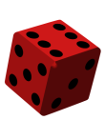
Now write a grammar of English
Here’s one to start with.
S
1 S → NP VP .
1 VP → VerbT NP
20 NP → Det N’
1 NP → Proper
20 N’ → Noun
1 N’ → N’ PP
1 PP → Prep NP
1
NP
VP
.

Slide 16
Now write a grammar of English
Here’s one to start with.
S
1 S → NP VP .
1 VP → VerbT NP
20 NP → Det N’
1 NP → Proper
20 N’ → Noun
1 N’ → N’ PP
1 PP → Prep NP
NP
VP
.
20/21
Det
N’
1/21

Slide 17
Now write a grammar of English
Here’s one to start with.
S
1 S → NP VP .
1 VP → VerbT NP
20 NP → Det N’
1 NP → Proper
20 N’ → Noun
1 N’ → N’ PP
1 PP → Prep NP
NP
VP
.
Det
N’
drinks [[Arthur [across
the [coconut in the castle]]]
[above another chalice]]
every
Noun
castle

Slide 18
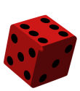
Randomly Sampling a Sentence
S
S → NP VP
NP → Det N
NP → NP PP
VP → V NP
VP → VP PP
PP → P NP
NP
VP
Papa
VP
PP
NP → Papa
N → caviar
N → spoon
V → spoon
V → ate
P → with
Det → the
Det → a
V
NP
P
NP
ate
Det
N
with
Det
N
the
caviar
a
spoon

Slide 19
Ambiguity
S
S → NP VP
NP → Det N
NP → NP PP
VP → V NP
VP → VP PP
PP → P NP
NP
VP
Papa
V
NP
NP → Papa
N → caviar
N → spoon
V → spoon
V → ate
P → with
Det → the
Det → a
ate
NP
PP
Det
N
P
NP
the
caviar
with
Det
N
a
spoon

Slide 20
Ambiguity
S
S → NP VP
NP → Det N
NP → NP PP
VP → V NP
VP → VP PP
PP → P NP
NP
VP
Papa
VP
PP
NP → Papa
N → caviar
N → spoon
V → spoon
V → ate
P → with
Det → the
Det → a
V
NP
P
NP
ate
Det
N
with
Det
N
the
caviar
a
spoon

Slide 21
Parsing
S → NP VP
NP → Det N
NP → NP PP
VP → V NP
VP → VP PP
PP → P NP
NP → Papa
N → caviar
N → spoon
V → spoon
V → ate
P → with
Det → the
Det → a
S
NP
VP
VP
PP
V
NP
P
NP
Det
N
Det
N
Papa
ate
the
caviar
with
a
spoon

Slide 22
Dependency Parsing
He reckons the current account deficit will narrow to only 1.8 billion in September .
SUBJ
MOD
MOD
COMP
MOD
SUBJ
COMP
SPEC
MOD
S-COMP
ROOT
slide adapted from Yuji Matsumoto

